Slide 1

Wastewater Treatment Plant
Demonstration Project

Slide 2
District Snapshot
Round Mountain WSD created in 1969
District Boundary – 6485 acres
District population – 1350
District MHI - $41,000 – Less than ½ state average
Silver Cliff and Westcliffe municipal water systems deeded to District in 1975 and connected to make one water system
Sewer collection system and treatment plant installed in 1975
26 miles of water mains, 18 miles of sewer mains
6 full-time staff
705 water taps, 688 sewer taps

Slide 3
WWTP Replacement Design Challenges
3/16 – District retains a Design Engineer, obtains PELs from CDPHE, District chooses surface water discharge
6/16 – CDPHE informs District that EPA listed Grape Creek as impaired due to nutrient loading in DeWeese Reservoir. CDPHE recommends the District to change to a groundwater discharge.
7/16 – 3/17 – District argues with State and Feds that the WWTP design falls under the exemption categories listed in Reg 85. Feds claim 303D supersedes state exemptions.
4/17 – District re-designs WWTP for groundwater discharge. $6 million price estimate
12/17 – District submits PER to CDPHE
3/18 – CDPHE requires 6-month TDS study

Slide 4
9/18 – District acquires financing to pay for $6 million plant
11/18 – CDPHE requires soil core sampling at leach field site. Soils found unsuitable and CDPHE rejects groundwater discharge design
12/18 – District forced to go back surface water discharge. Requests new PELs from CDPHE
5/19 District receives PELS. Very strict limits drive a major re-design of the WWTP
7/20 – District receives WWTP Project approval from CDPHE
8/20 – District receives updated project cost estimates from design engineer. Cost more than doubles from $6 million to $14.1 million, far beyond the District’s ability to finance
9/20 – After 5 years and over $675,000 invested in engineering, the District is back at square one without a treatment solution.

Slide 5
Proposed New Discharge Limits
BOD – 30 mg/l
TSS – 30 mg/l
OG – 10 mg/l
pH – 6.5-9.0
ECOLI – 126 (#/100 ml)
TRC - .017 mg/l
TIN – 105 mg/l
AMN – 21 – 36 mg/l
TN – 9.1 mg/l
Arsenic – 0.02 ug/l
Phosphate – 0.025 mg/l
In Colorado, Regulation 31.17 will take effect as of December 31, 2027, requiring virtually every wastewater treatment facility in the state to remove nutrients at some level.
Unfortunately, the vast majority of existing wastewater treatment plants were never designed to remove nutrient parameters.
Mechanical treatment plants are unaffordable for most small and rural communities. It is imperative that an affordable and effective treatment solution become available.

Slide 6
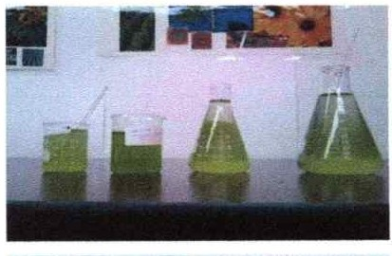
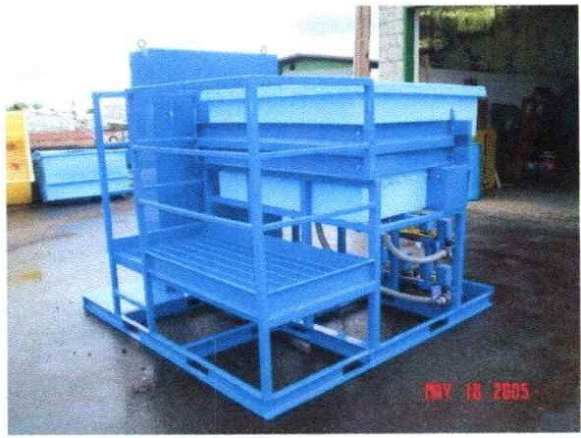
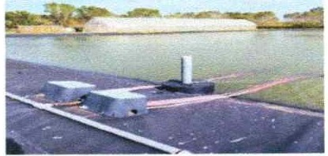
Powell Water Microalgae System (PWMAS)
Step One
Biological Oxygenation
Bioaugmentation
Step Two
Electrocoagulation

Slide 7
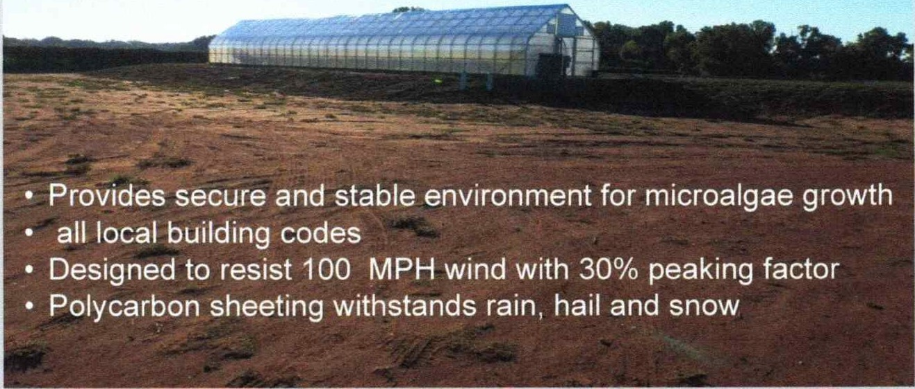
Microalgae/Microbe Incubation Greenhouse

Slide 8
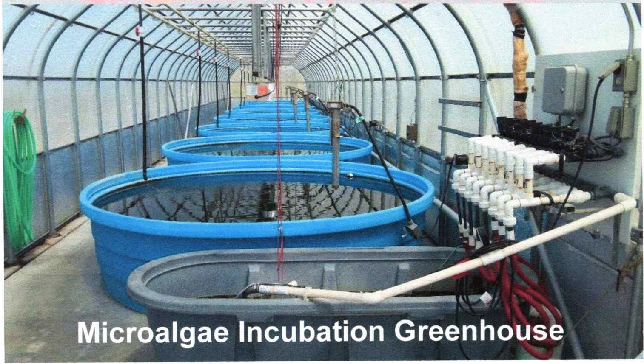

Slide 9
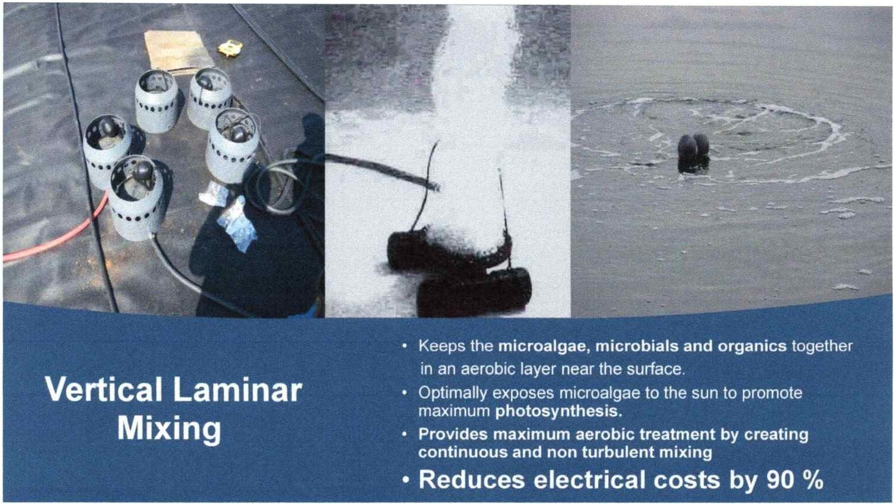

Slide 10

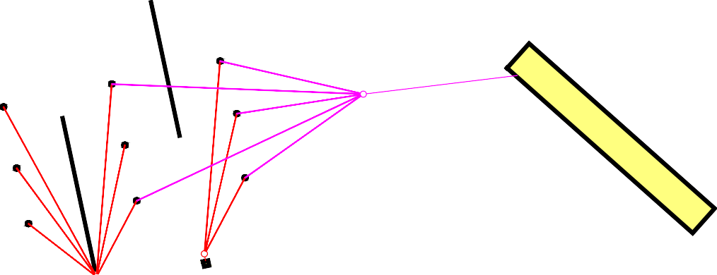
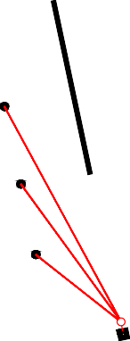

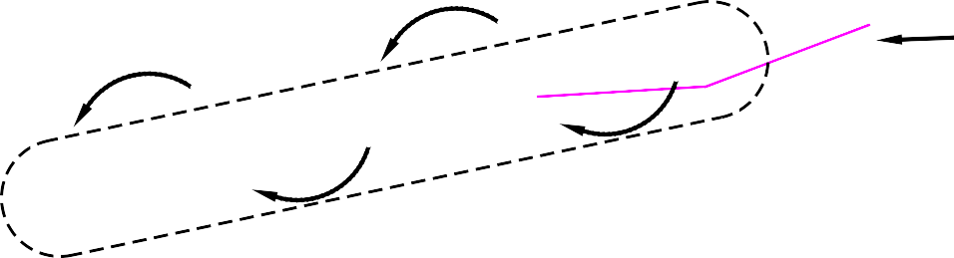

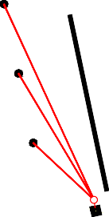
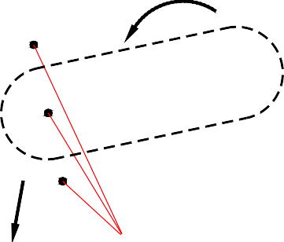
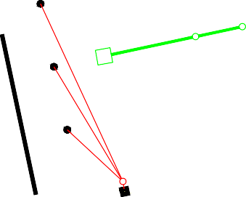




Round Mountain Water and Sewer District Pilot Project Wastewater Treatment (Phase 1)
Drawing Revision Table
Revision ID
Existing System (Cells 1, 2 & 3)
Pilot Project (Cells 4, 5 & 6)
Fence Line
Date
Project No. CO144
09/09/2023
JWC
MPOe JWC
Electrical Power Line
Designed:
Drawn: Checked:
Air Lines (Typical) Fine Bubble Diffuser (Typical)
Date:
Force Main to Existing Discharge System
40' x 40' EC Building with 10' x 10' Sludge Drying Basin (Sheet 7)
Top of Lagoon
Culture Lines
Lagoon Logistics, LLC 5908 Sapling Street
Fort Collins, CO 80528-7251 jeffcouch@comcast.net
16' x 96' Algae & Microbe Incubation Greenhouse (Sheet 9)
Lift Pump
Bottom of Lagoon
Cell 4
¹₂ HP Air Compressor (Typical)
Auger Screen
Cell 5
Diversion Curtain (Typical)
Force Main
Cell 6
Electrical
Existing Lift Pump to Land Application Site (002A)
Cell 1
Electrical Control Station
Round Mountain W & SD
Custer County, Colorado
Pilot Project Wastewater Treatment (Phase 1) Proposed Pilot One Improvements
Cell 2
To Existing Filter Beds (001A)
Cell 3
Electrical
Fence Line
0
20'
40'
80'
SCALE: 1" = 40'-0"
Sheet 5 of 17
Plotted:9/9/2023
Copyright 2023 Lagoon Logistics, LLC, All rights reserved
File Name:5 Proposed Pilot One Improvements.dwg

Slide 11
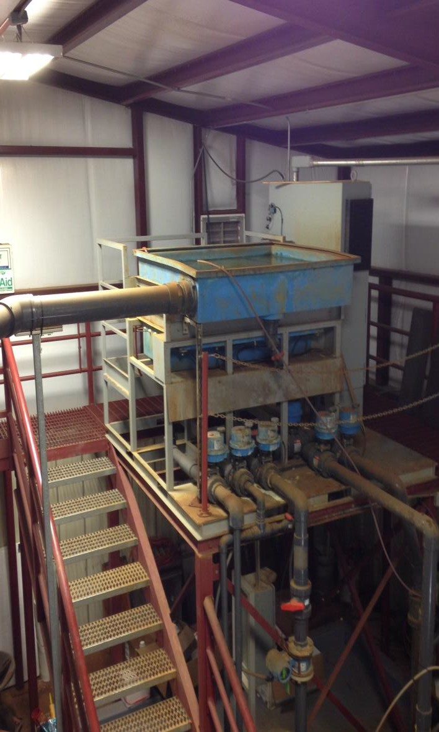
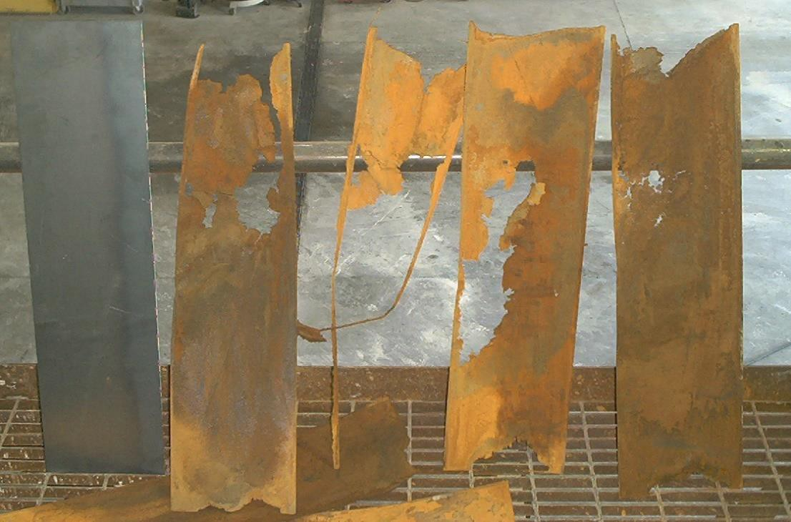

Powell Water Electrocoagulation
uses electricity and sacrificial metal blades/plates
to coagulate solids
NEW
10 gpm
50 gpm Tertiary Treatment Oklahoma WWTP
USED

Slide 12
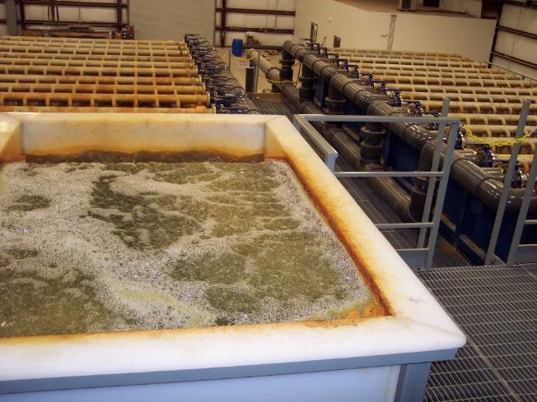
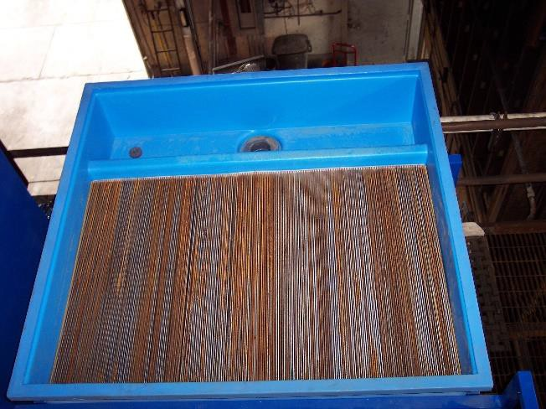
Electrocoagulation
Electrocoagulation is the process of destabilizing suspended, emulsified or dissolved contaminants in an aqueous medium by introducing an electrical current into the medium.
500 gpm
1,866,240 square inch Wet blade surface area
50 gpm
186,624 square inch Wet blade surface

Slide 13

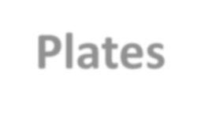
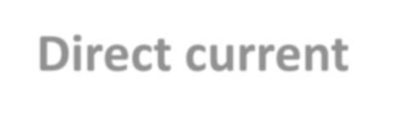




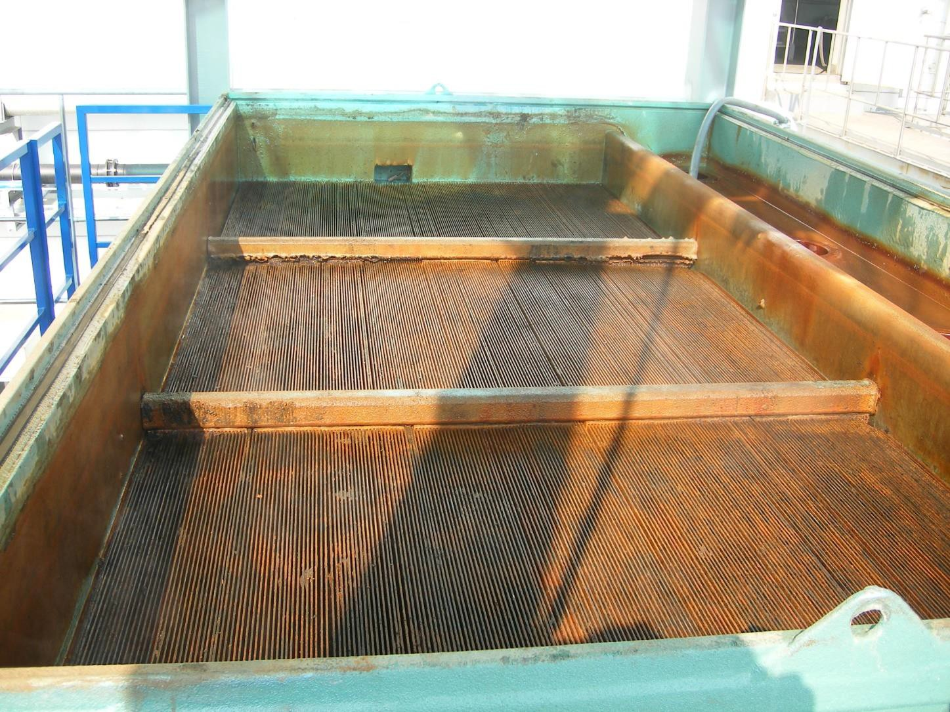
Plates are placed vertically within the patented reaction chamber
Direct current is applied to the first and last blade
Untreated water is introduced into the bottom of the chamber
Water is dispersed evenly as it moves upward through the blades
Water conducts electricity throughout the chamber
_
+
Samsung 600 gpm unit South Korea

Slide 14



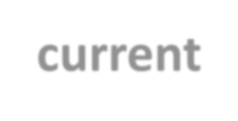

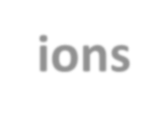




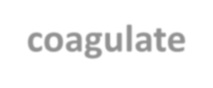
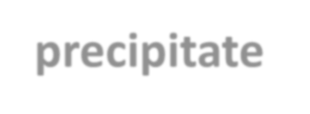


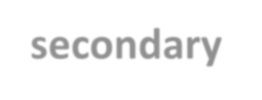
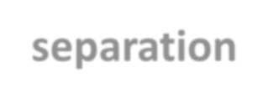
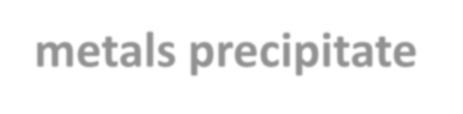
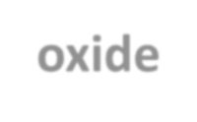



Metal blades react to the current by releasing charged metal ions
This electron flooded water neutralizes charged particles, making constituents coagulate and thus separable (precipitate )
_
+
Electron flooded / treated water overflows to secondary separation such as ponds, clarifiers, filters, or etcetera.
Central Wastewater Treatment Facility 50 gpm, Denver, Colorado
Heavy metals precipitate into acid-resistant oxide sludge that passes the Toxic Classification Leaching Procedure (TCLP), making the sludge non-hazardous

Slide 15
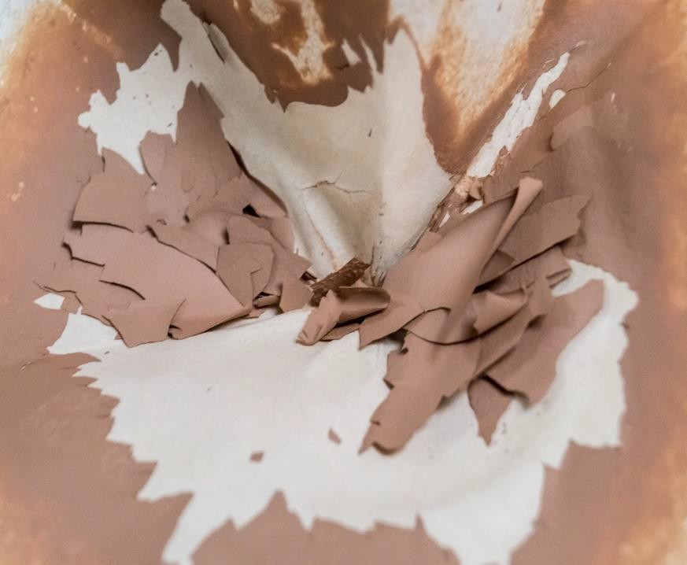
Sludge from EC:
Solids dewater completely
Metals are non-hazardous form as oxides
Does not leach at ambient landfill pH
Passes EPA TCLP and California Title 22 STLC and TTLC leach tests

Slide 16
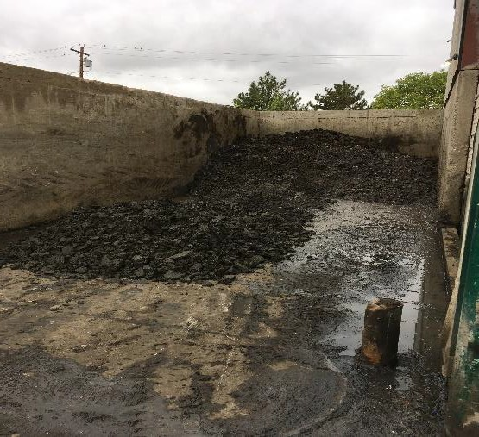
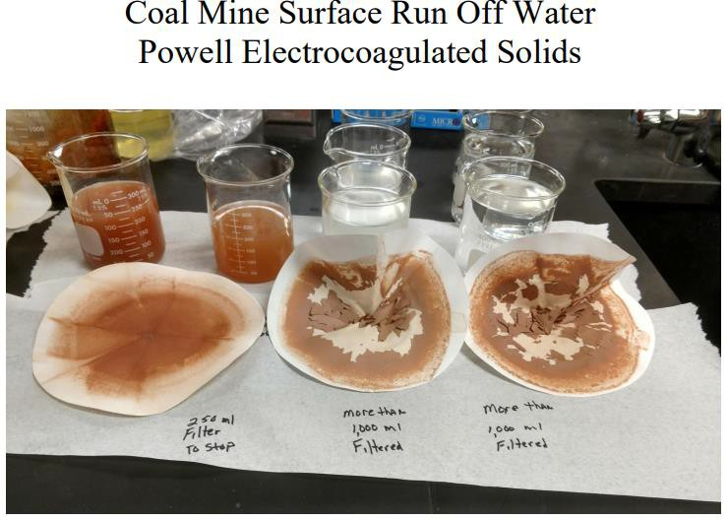
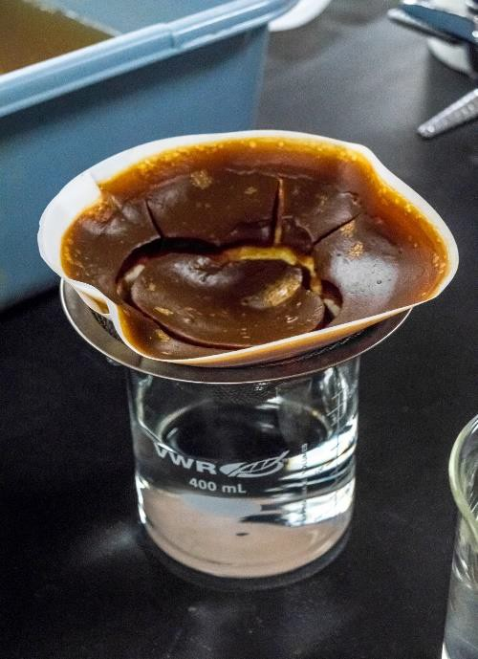
EC Solids Dry in the Oxide Form

Slide 17
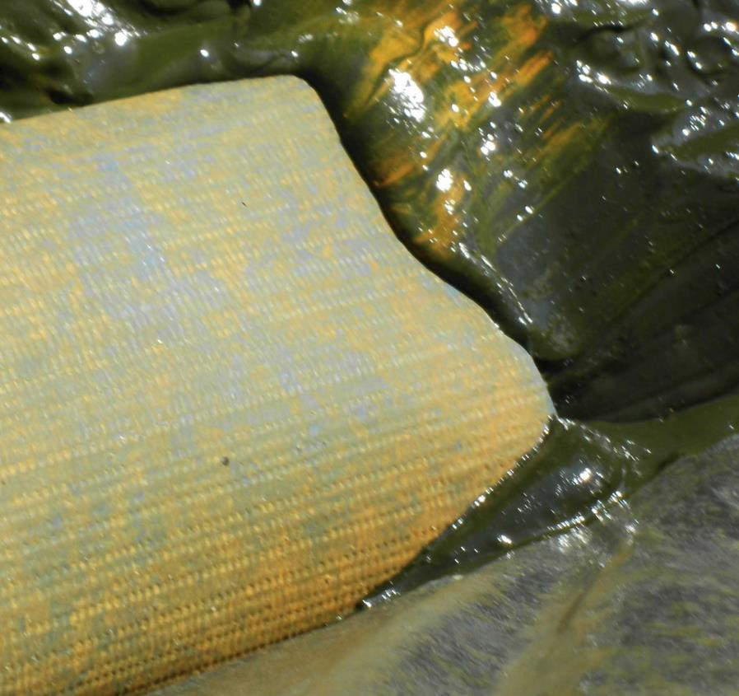
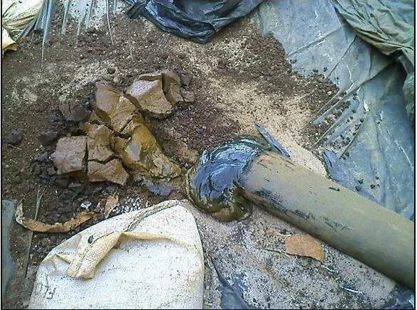
Solids Handling
“When compared with alum treatment, electrocoagulation provided approximately 83% less sludge volume and a 76% improvement in filtration rate.”
EPA / 540 / S-937504 September 1993 Emerging Technology Summary, Superfund Innovative Technology Evaluation

Slide 18
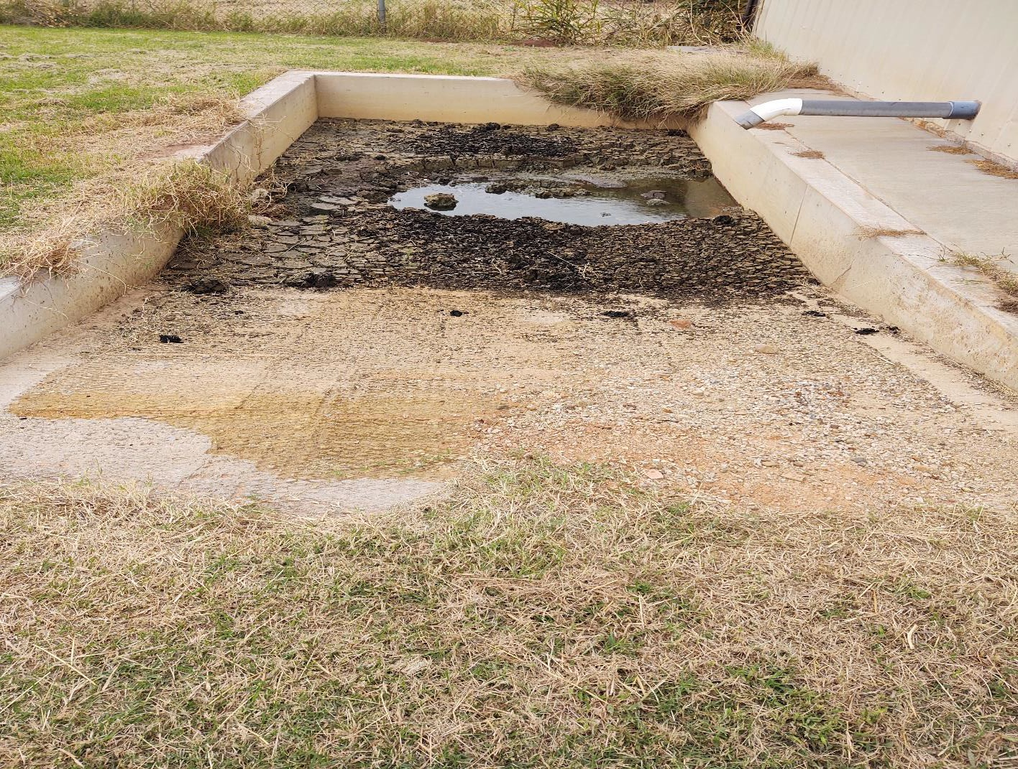
Municipal System – Oklahoma Post EC Drying Bed

Slide 19
Typical Removal Rates
Contaminant | Before (mg/l) | After (mg/l) | % Removal
Aluminum | 224 | ND (0.7) | 99+
Arsenic | 0.076 | ND (<0.002) | 97
Barium | 0.014 | ND (<0.001) | 93
Boron | 4.86 | 1.41 | 70
Cadmium | 0.125 | ND (<0.004) | 96
Calcium | 1,321 | 21.4 | 98
Chromium | 139. | ND (<0.1) | 99+
Cobalt | 0.1238 | 0.0214 | 82
Copper | 0.7984 | ND (<0.0020) | 99+
Cyanide (free) | 723 | ND (<0.02) | 99+
Fluoride | 1.1 | 0.415 | 62
Gold | 5.72 | 1.38 | 75
Iron | 68.34 | 0.19 | 99+
Lead | 0.59 | 0.0032 | 99+
Magnesium | 13.15 | 0.04 | 99+
Manganese | 1.061 | 0.018 | 98
Mercury | 0.72 | ND (<0.003) | 98
Molybdenum | 0.35 | 0.029 | 91
Nickel | 183 | 0.07 | 99+
Platinum | 4.4 | 0.68 | 84
Selenium | 68 | 38 | 44
Silicon | 21.07 | ND (0.10) | 99+
Silver | 0.0081 | 0.0006 | 92
Tin | 0.213 | ND (<0.020) | 90
Vanadium | 0.262 | ND (<0.002) | 99+
Zinc | 221 | 0.140 | 99+
Metals And Minerals

Slide 20
Biologicals
Contaminant | Before | After | % Removal
Bacteria | 110,000,000 cfu | 2,700 cfu | 99+
Coliform | 318,000,000 cfu | ND (<1) cfu | 99+
E. coli | >2,419.2 mpn | ND (<0.01) mpn | 99+
Enterococcus | 83 mpn | ND (<10) mpn | 82
Total Coliform | >2,419.2 mpn | ND (<0.1) mpn | 99+
Cyanotoxin | 67.7 ug/l | 2.2 ug/l | 97

Slide 21
Nutrients
Contaminant | Before (mg/l) | After (mg/l) | % Removal
Ammonia | 49 | 19.4 | 60
Nitrate | 11.7 | 2.6 | 77
Nitrite | 21 | 12 | 42
Nitrogen TKN | 1,118.88 | 59.08 | 94
Phosphate | 28 | ND (0.2) | 99+
Potassium | 200 | 110 | 45
Sulfate | 104 | 68 | 34
Removal rates without processing aids like micro algae, hydrogen peroxide

Slide 22
PWMAS Small Scale Test Results
BOD – 30 mg/l
TSS – 30 mg/l
OG – 10 mg/l
pH – 6.5-9.0
ECOLI – 126 (#/100 ml)
TRC - .017 mg/l
TIN – 105 mg/l
AMN – 21 – 36 mg/l
TN – 9.1 mg/l
Arsenic – 0.02 ug/l
Phosphate – 0.025 mg/l
BOD – 3 mg/l
TSS – ND
OG – ND
pH – 6.5-9.0
ECOLI – ND
TRC - ND
TIN – 7.9 mg/l
AMN – 3.2 mg/l
TN – 7.9 mg/l
Arsenic – ND
Phosphate – ND

Slide 23
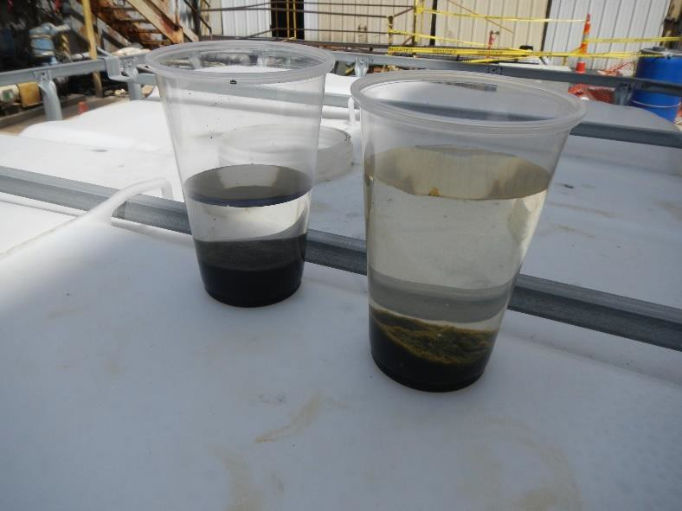
Powell Water System, Inc.
Electrical Treatment Advantages
PFOA/PFOS (Removal in Both Water and Solids)
Solid Removal with Water Reduction
Arsenic Removal Below Detectable Limits
Metal Removal
Effective Disinfection
Nutrient Removal
Low Initial Investment
Low Operating Costs

Slide 24
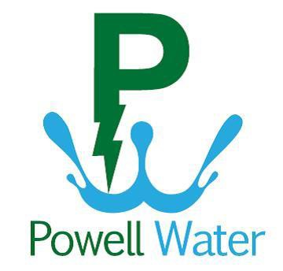
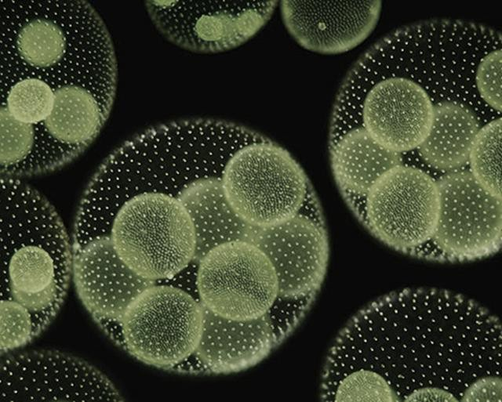
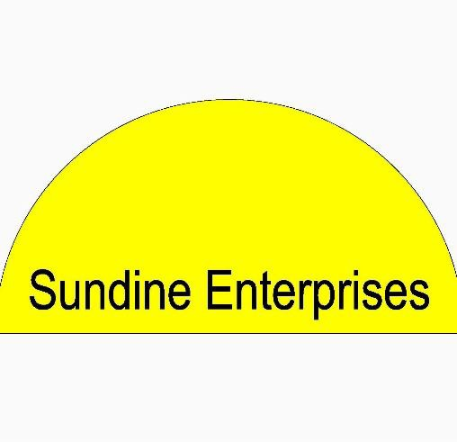

Design, Build and Operation
Electrocoagulation
Equipment
Microalgae Assemblages
Powell Water System, Inc.
Scott Powell, President
(303) 241-2489
Lagoon Logistics, LLC
Jeff Couch, President (970) 231-9937
Sundine Enterprises, Inc.
Judd Sundine, Horticulturist (720) 363-0548
United States Patent Number 10358361 B2. System and Method for Remediation of Wastewater Including Aerobic, Anaerobic and Electrocoagulation Technology. This patent is wholly licensed by Powell Water Systems, Inc.

